Slide 1
Scrum Team 2 Product Release
Scrum Master :
Elgin Bowman
Development Team :
Scott Troutman, Adam Ingram, Johnny Hosler, Brandon Taylor, Pengzheng Yang, Zachary Alwine

Slide 2
Overview
ArgumentParser allows for the creation of different types of arguments and store data parsed from the command line.
Allows created arguments to be saved to and loaded from an XML file using the XMLManager class.
In-depth documentation found at add link here

Slide 3
Features
Positional Arguments
Holds a name, description, and data type
Can be restricted to a certain set of values
Throws exception if value provided doesn’t match data type
Throws exception if too few/many positional arguments are used

Slide 4
Features
Named Arguments
Inherits functionality from positional arguments
Stores a default value
Can be assigned and called by a pre-defined shorthand name
Can be set to be required
Can store multiple values
Can be assigned to a mutually exclusive group

Slide 5
Testing & Code Coverage
--% Pass rate on unit testing
--% Pass rate on acceptance testing
--% Code coverage

Slide 7
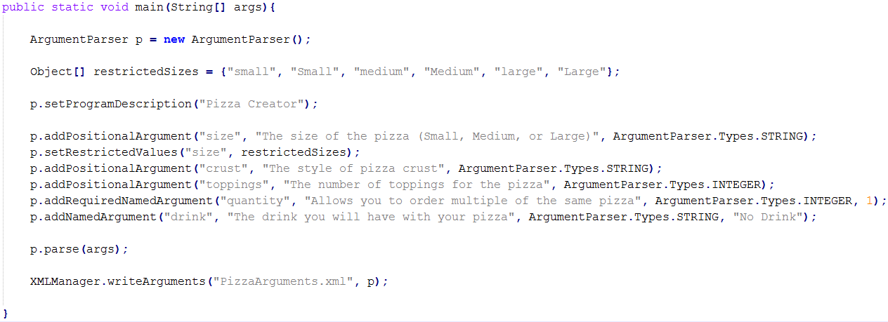
Writing Arguments

Slide 8
Running XML Write Demo
Ran with parameters:
Result: XML File

Slide 9
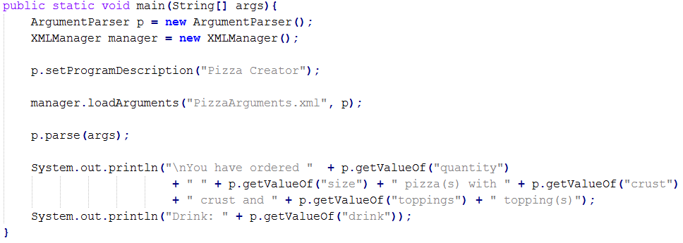
Loading Arguments

Slide 10
Running XML Load Demo
Ran with parameters:
Result:

Slide 11
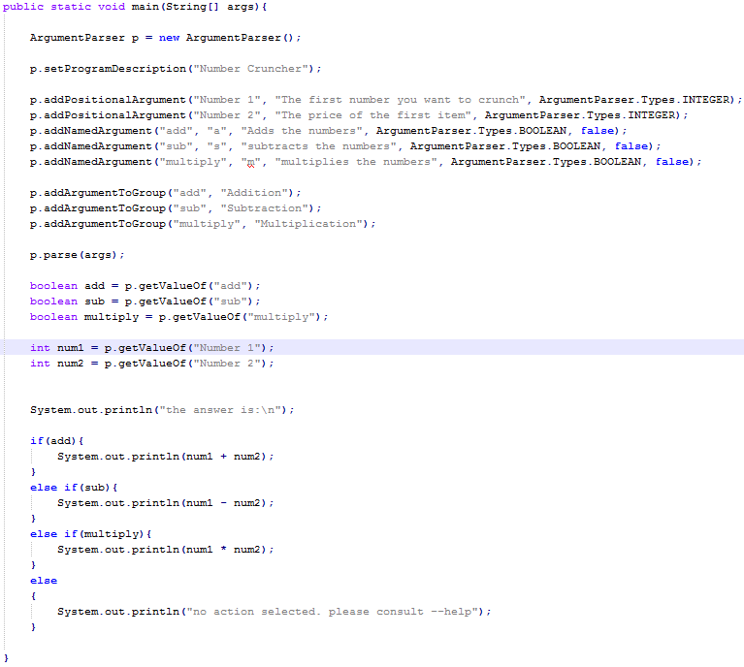
Mutually Exclusive Demo Using Shorthand Arguments

Slide 12


Running the Addition Demo
Ran with parameters:
Result:

Slide 13


Running the Subtraction Demo
Ran with parameters:
Result:

Slide 14

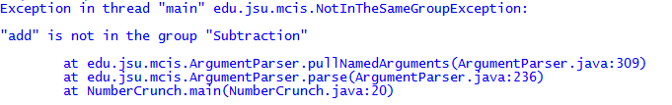
Failing Mutual Exclusion
Trying to run previous demo with parameters:
Result

Slide 15
Burndown Chart

Slide 16
SCRUM Stuff

Slide 17

Thank You For Your Time

